Slide 1

Capstone Project
Zomato Clustering & Sentiment Analysis
Presented by:
Gayatri Surapaneni

Slide 2
Contents
Introduction
Problem Statement
Methodology
Loading the data
Exploratory Data Analysis
Treating missing values and outliers
Natural Language Processing
Clustering
Sentimental analysis
Building models
Hyper parameter tuning
Conclusion

Slide 3
Problem Statement
India is quite famous for its diverse multi cuisine available in a large number of restaurants and hotel resorts, which is reminiscent of unity in diversity. Restaurant business in India is always evolving day by day. Zomato a online food delivery website is the perfect example of this.
The Project focuses on Customers and Company, you have to analyze the sentiments of the reviews given by the customer in the data and made some useful conclusion in the form of Visualizations. Also, cluster the zomato restaurants into different segments.
This could help in clustering the restaurants into segments. Also the data has valuable information around cuisine and costing which can be used in cost vs. benefit analysis.
Data Sets Given
Zomato Restaurant names and Metadata
This dataset gives the information about the restaurants, cuisines, collections available
Zomato Restaurant reviews
This Dataset gives the information of the reviewers and followers of the every restaurants which are available

Slide 4
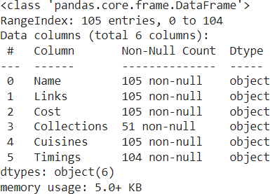
Description of Zomato Restaurant names and Metadata Dataset
1.Name : Name of Restaurants 2.Links : URL Links of Restaurants
3.Cost : Per person estimated Cost of dining 4.Collection : Tagging of Restaurants with respect to Zomato categories
5.Cuisines : Cuisines served by Restaurants 6.Timings : Restaurant Timings

Slide 5
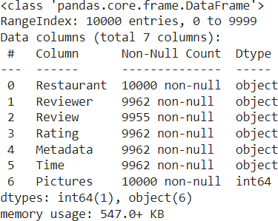
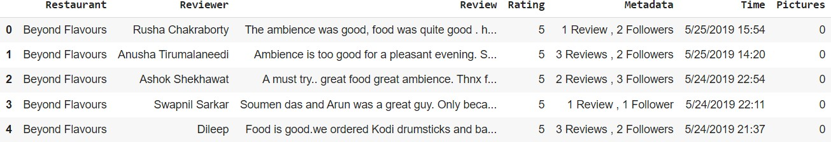
Description of Zomato Restaurant reviews
1.Restaurant : Name of the Restaurant 2.Reviewer : Name of the Reviewer 3.Review : Review Text
Rating : Rating Provided by Reviewer
MetaData : Reviewer Metadata - No. of Reviews and followers 6.Time: Date and Time of Review
7.Pictures : No. of pictures posted with review

Slide 6
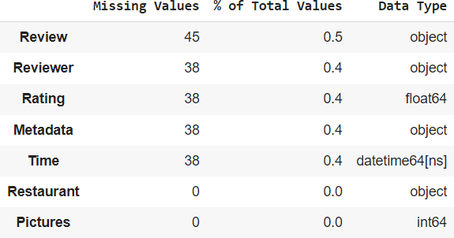
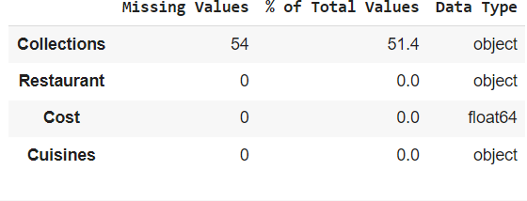
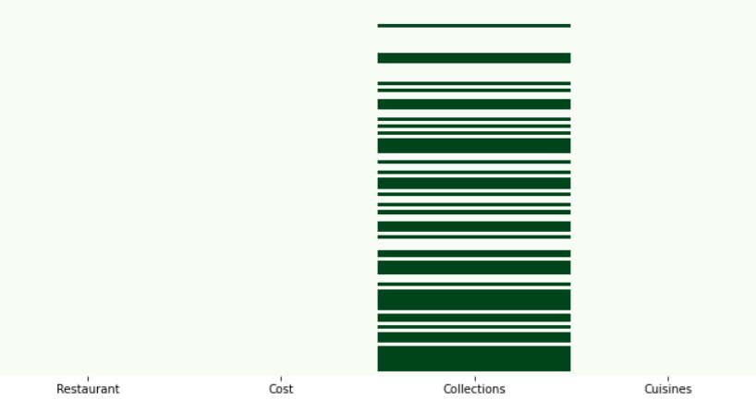
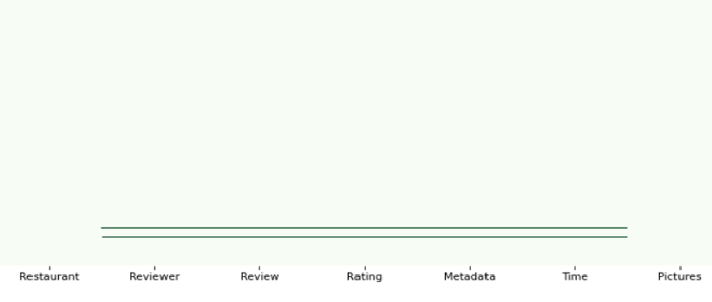
Exploratory Data Analysis
Zomato Restaurant names and Metadata
Zomato Restaurant reviews

Slide 7
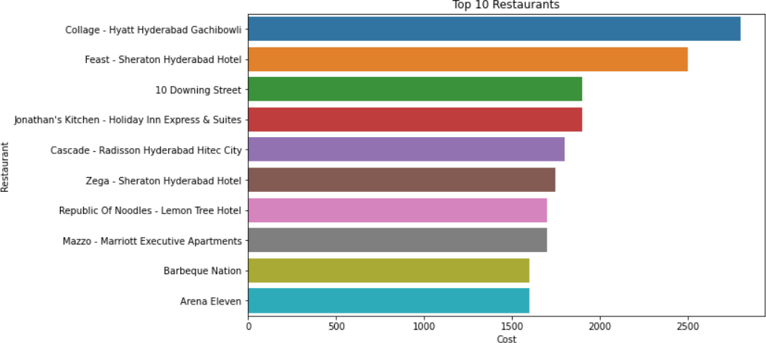
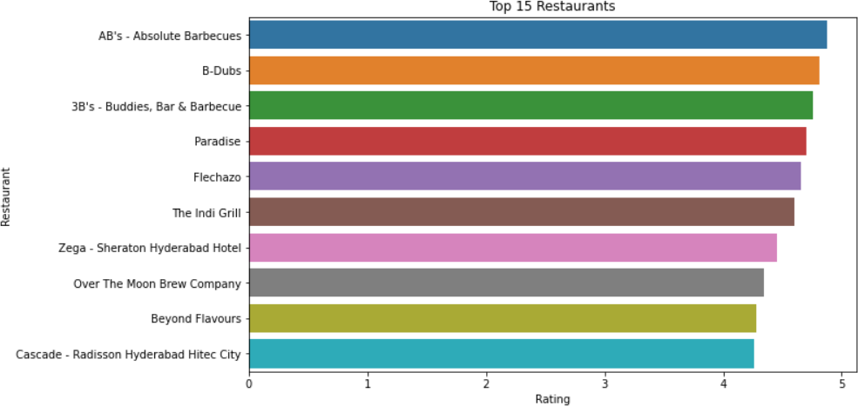
Costly Restaurants
Top Restaurants based on Rating
These graphs represents the top 10 restaurants with respect to cost and Rating

Slide 8
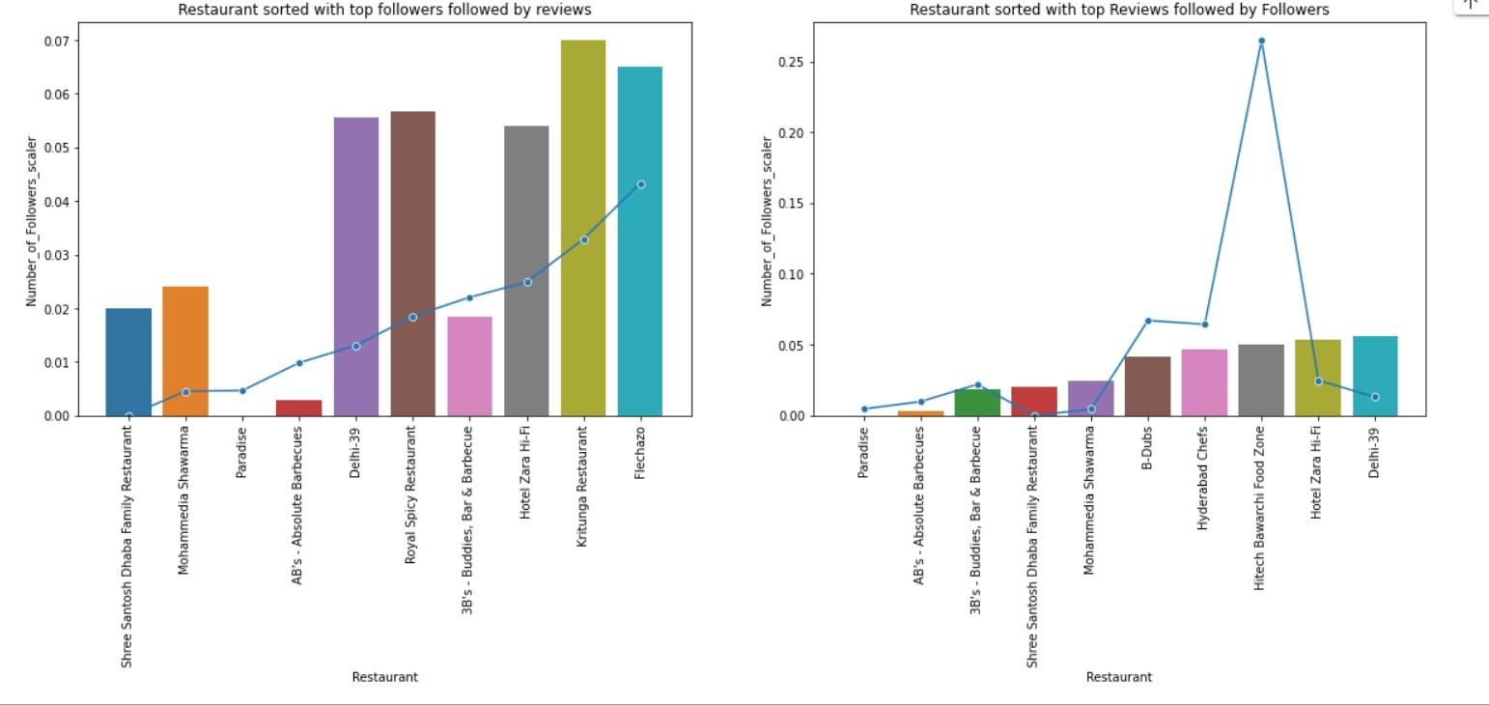
Graph which represents the number of followers and number of reviews for each restaurants
Restaurants with maximum followers
Restaurants with more reviews

Slide 9
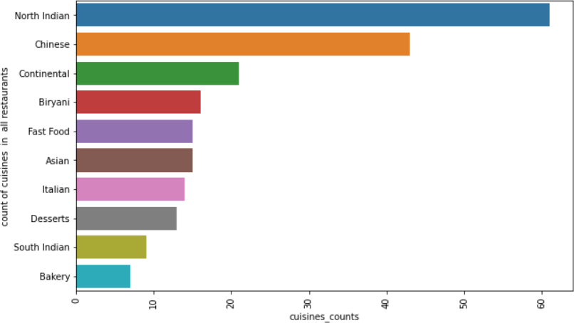
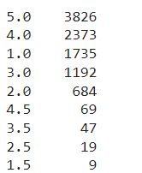
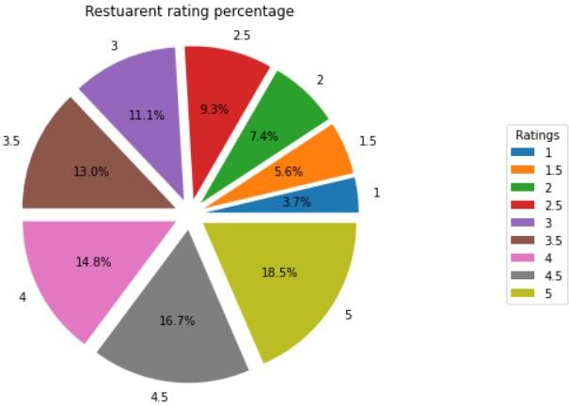
Restaurants available wrt different
Ratings
3826 restaurants available
with rating 5
Famous Cuisines offered by Restaurants
'North Indian' is the Popular Cuisine which is offered by almost many restaurants. And 'Malaysian' is the rare cuisine.

Slide 10
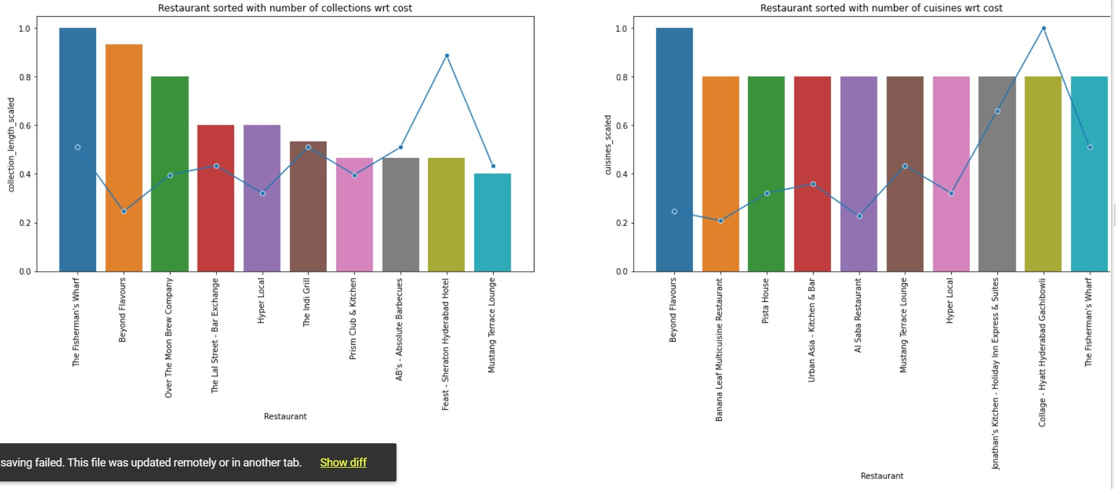
Total number of collections and cuisines wrt cost offered by each restaurant

Slide 11
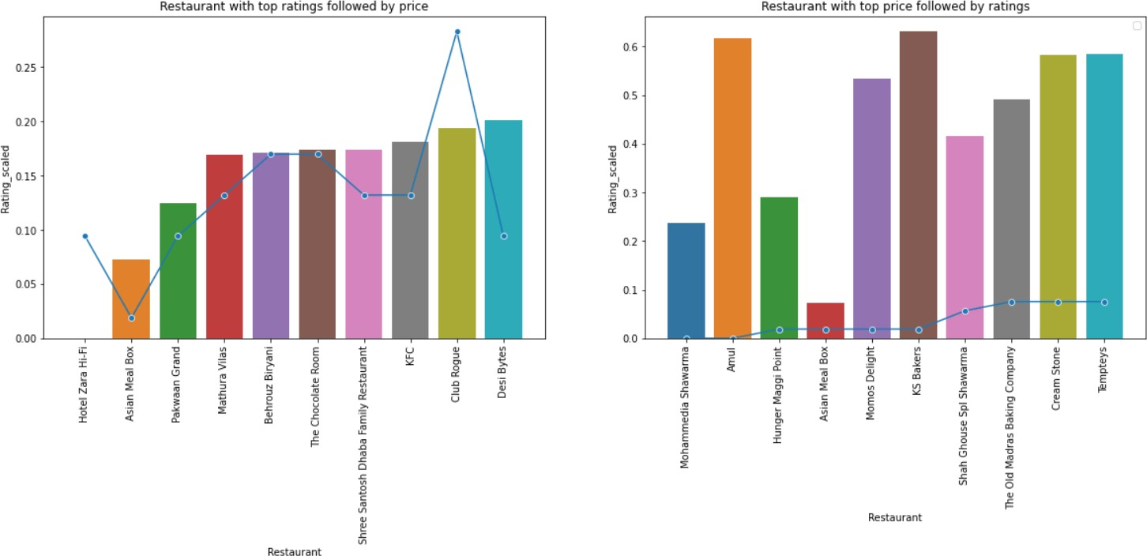
Best Restaurant with respect to ratings and price

Slide 12
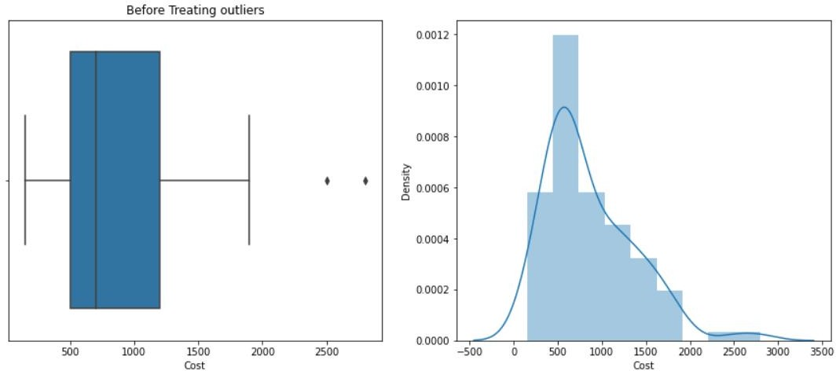
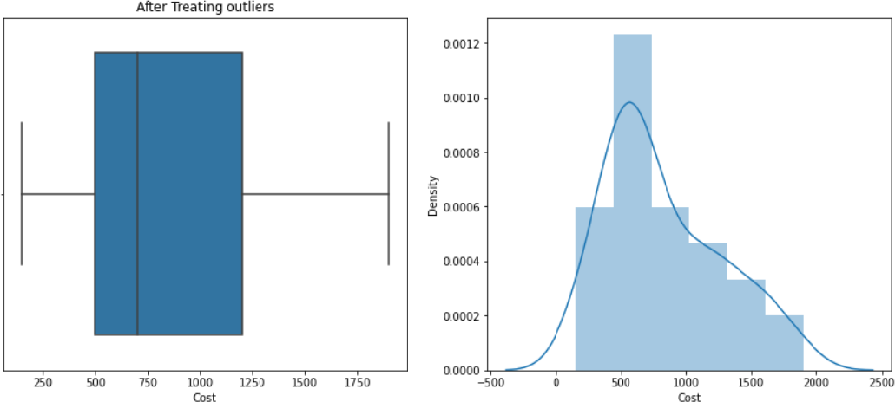
Treatment of Missing Values and Outliers
Treatment of missing values
Zomato Restaurant names and Metadata
Dataset contains 54% missing values in collections feature. Since it is a string, it is treated by replacing null values with Unknown.
As we have seen from missing values graph of Zomato Restaurant reviews, it has null values at the same position of every feature. So these null values are dropped.
Treatment of Outliers
Outliers treatment in this data set is treated by
z score.

Slide 13
Natural Language Processing
Natural Language Processing (NLP) refers to AI method of communicating with an intelligent
systems using a natural language such as English.
Since we have sentences in or dataset we have used, NLP to process them.
Steps Involved
Removing of stop words punctuations, emojis etc from the text.
Count Vectorizer : CountVectorizer is used to transform a corpora of text to a vector of term /
token counts.
Stemming and lemmatization: these two are the text normalization techniques. These methods are
used to process the text accordingly.
TFIDF vectorizer: TF-IDF is an abbreviation for Term Frequency Inverse Document Frequency. This is very common algorithm to transform text into a meaningful representation of numbers which is used to fit machine algorithm for prediction
Feature Engineering
Feature engineering is the process of selecting, manipulating, and transforming raw
features that can be used in supervised learning.
Feature Engineering consists of various process :
Feature Creation (2) Transformation (3) Feature Selection
data into

Slide 14
Clustering
Cluster analysis, or clustering, is an unsupervised machine learning task. Similarity between observations is defined using some inter-observation distance measures or correlation-based distance measures.
It involves automatically discovering natural grouping in data. Unlike supervised learning (like predictive modeling), clustering algorithms only interpret the input data and find natural groups or clusters in feature space.
Cluster analysis is an iterative process where subjective evaluation of the identified clusters is fed back into changes to algorithm configuration until a desired or appropriate result is achieved.
Clustering techniques we have used are
Affinity Propagation
Hierarchial Clustering
dbscan clustering
K Means Clustering
mini-batch k-means

Slide 15
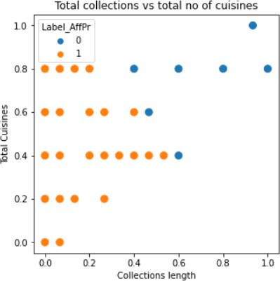

Affinity Propagation
Affinity Propagation involves finding a set of
exemplars that best summarize the data.
It is implemented via the Affinity Propagation class and the main configuration to tune is the “damping” set between 0.5 and 1, and perhaps “preference.”
Clustering has done on Total Cuisines and
collections length

Slide 16
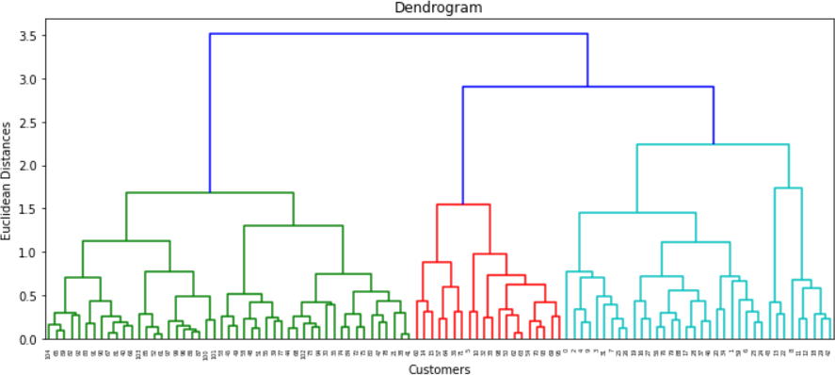
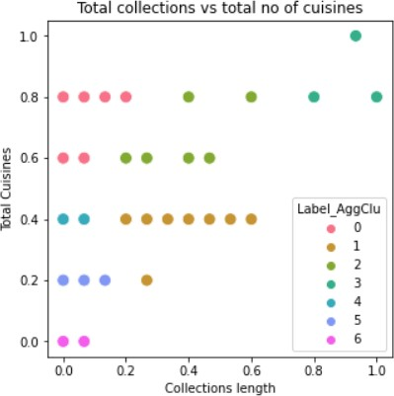
Hierarchial Clustering
Agglomerative Hierarchial Clustering
In agglomerative hierarchical algorithms, each data point is treated as a single cluster and then successively merge or agglomerate (bottom-up approach) the pairs of clusters.
Hierarchical clustering is used to group together the unlabeled data points having similar characteristics.

Slide 17
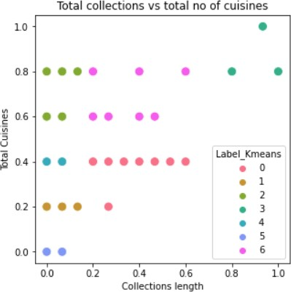
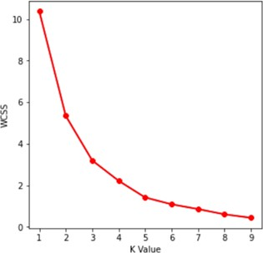
K means Clustering
It is an iterative algorithm that divides the unlabeled dataset into k different clusters in such a way that each dataset belongs only one group that has similar properties.
K defines the number of pre-defined clusters that
need to be created in the process.
Elbow Method
K value is determined by elbow method

Slide 18
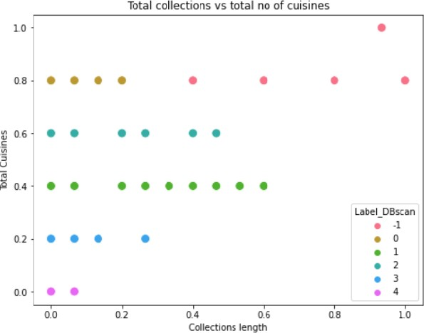
dbScan Clustering
DBSCAN stands
for density-
based spatial clustering of applications with noise. It is able to find arbitrary shaped clusters and clusters with noise (i.e. outliers).
The main idea behind DBSCAN is that a point belongs to a cluster if it is close to many points from that cluster.
There are two key parameters of DBSCAN:
eps: The distance that specifies the neighborhoods. Two points are considered to be neighbors if the distance between them are less than or equal to eps. minPts: Minimum number of data points to define a cluster.

Slide 19
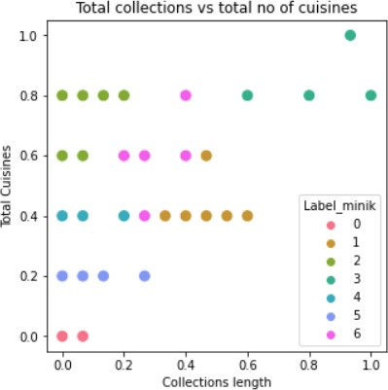
Mini-batch k-means
Mini-Batch K-Means is a modified version of k-means that makes updates to the cluster centroids using mini-batches of samples rather than the entire dataset, which can make it faster for large datasets, and perhaps more robust to statistical noise.
It is implemented via the Mini Batch KMeans class and the main configuration to tune is the “n_clusters” hyperparameter set to the estimated number of clusters in the data.

Slide 20
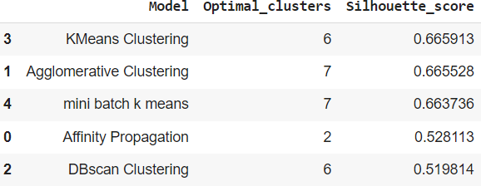
Validation
The term clustering validation is used to design the procedure of evaluating the results of a clustering algorithm.
Silhouette score -
Average average
silhouette silhouette
method computes the of observations for
different values of k. The optimal number of clusters k is the one that maximize the average silhouette over a range of possible values for k.
Through this data frame, we can conclude that the optimal number of clusters are 7 (or 6).
Except the affinity propagation, all other models are giving the optimal clusters as 7(or 6).

Slide 21
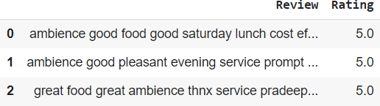
Sentimental Analysis
Sentimental Analysis is the process of classifying whether a block of text is positive, negative, or,
neutral.
The goal which Sentiment analysis tries to gain is to analyze people’s opinion in a way that it can help
the businesses expand.
It focuses not only on polarity (positive, negative & neutral) but also on emotions (happy, sad, angry,
etc.).
Steps Involved
1. Text Processing 2. Feature Engineering 3. Train-Test Split 4. Building Models
Test-Processing
In this step all the stop words, punctuations, emojis, special characters etc are removed from the text. Then
lemmatization has been applied

Slide 22
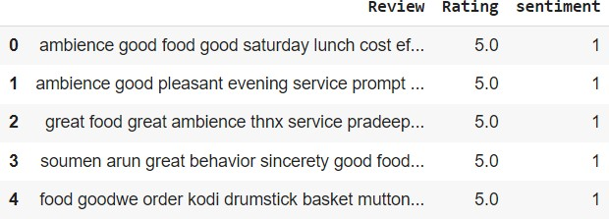
Feature Engineering
A new feature sentiment is created according to the rating. If the rating > 3.5 then the sentiment is positive(1). If the rating < 3.5 then the sentiment is considered as negative(0).
Train-Test Split
The dataset is split into Train – Test datasets. This is done to ensure that our test dataset is completely
isolated and there is no information leakage during the training process of machine learning models.
Since we have considered Review column Tfidf vectorizer id applied on it.

Slide 23
Building Models
Since we have sentiment as a class(1 and 0) we have build classification models on
this data.
There are many classification models available in supervised machine learning. The models which we have used are,
Logistic regression
Decision Tree
Random Forest
K – nearest neighbor
XGBoost
LGBM
Support Vector Machine (SVM)
Multinomial Naïve Baye’s

Slide 24
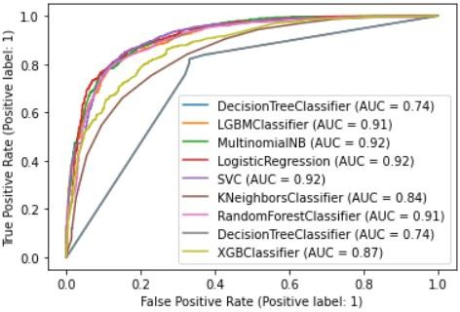
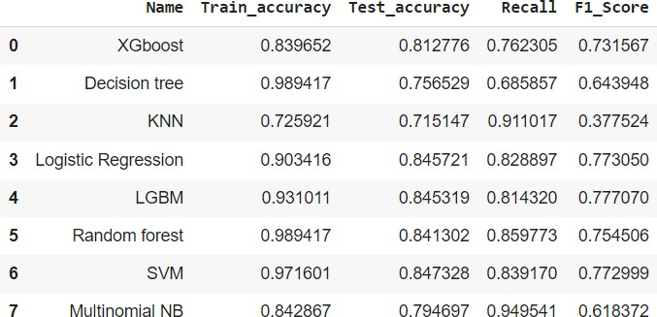
ROC Curve for different models
Evaluation metric for all the models
According to ROC curve, LGBM, Multinomial NB and Logistic regression are performing good.

Slide 25
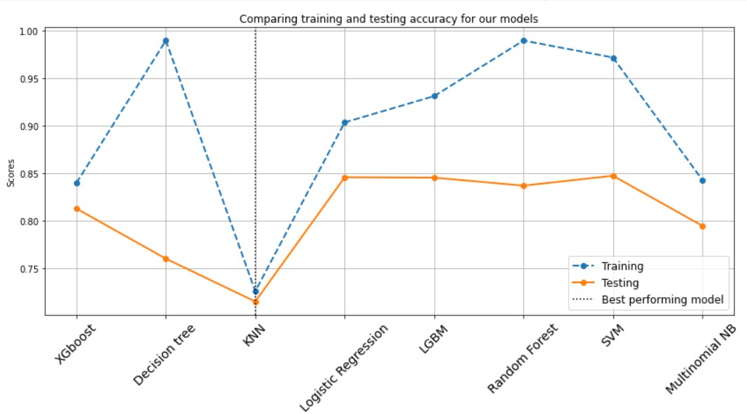

Slide 26
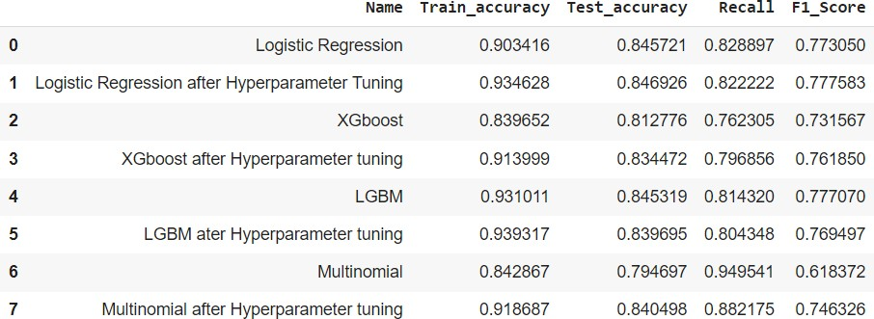
Hyperparameter Tuning

Slide 27
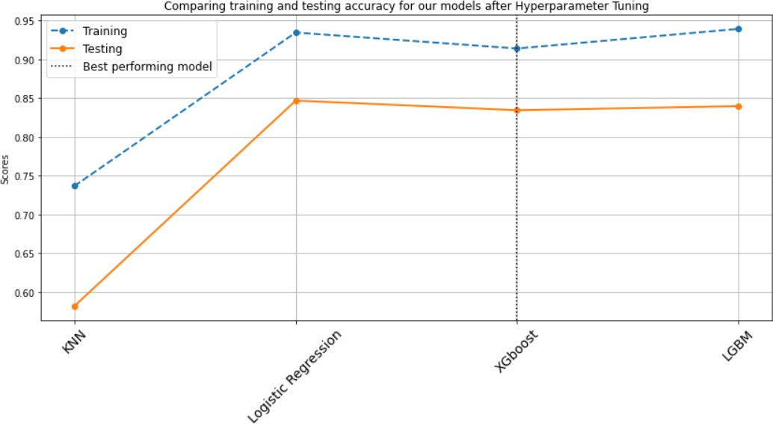
Conclusion
We can observe that Logistic regression is working good. Its accuracy and recall is more when compared to other models. So we conclude that that Logistic regression is the best model in this sentimental analysis.

Slide 28
Challenges faced
In the metadata(for clustering), we had only 100 rows and 4 variables to learn. After building the models, we found the silhouette score different number of clusters. We mainly focused on the silhouette score to evaluate the models. We were able to secure only around 0.6 silhouette score from all different models whose optimal number of clusters were to be 6 or 7.
In the reviews data(for sentiment analysis), to find the feature for the analysis was a tedious task. We made the split for rating and created another feature which is further used for sentimental analysis. But while creating this another feature, we first took 3 partitions for rating (average, good and best). But we did not get good result from the feature with 3 splits. Later another feature was created with 2 splits from rating(1 and 0)
Overall, we succeeded with good Silhouette score of 0.6 with 6 optimal clusters in clustering. And in Sentiment Analysis, we got the train and test accuracy as good as 0.9 and 0.84.
References
Analytics Vidhya
GeeksforGeeks
Medium

Slide 29
Thank You

